Slide 1


SAP CLOUD APPLICATION PROGRAMMING AND XSA TRAINING IN BTP
Anubhav Oberoy
Day – 6

Slide 2

Agenda – Day 6
Solving the issue of exposure of calculation view
What is SQL Script?
Advantage of SQL Script
Types of SQL Script
Basic Rules of creating SQL Script
How to create SQL Script in HANA
Create Anonymous Block
Create First Procedure
Expose Procedure as a Service
What is Data flow Logic?
Deep dive inside procedure
Simple procedure with database SELECT
Parameterized procedure
Using Implicit table variables in procedure
Create SQL Script Library
Consume library
Create SQL Script functions
Difference between procedure and functions
Calling functions in procedure
Debugging SQL Script code

Slide 3
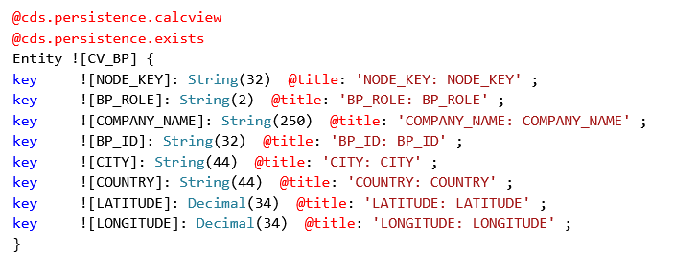
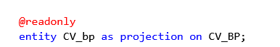
Expose View as a Service in CAP
Following are the steps to expose a view as a CAP Service in BTP
Go to the db folder inside the CAP project – cd db
Compile the View code to CDS code – hana-cli inspectView –v VIEW_NAME -o cds
Copy the generated code to the datamodel.cds file with below annotations
@cds.persistence.calcview
@cds.persistence.exists
Expose the service in CatalogService.cds file as a @readonly Entity
Test the OData Service

Slide 4
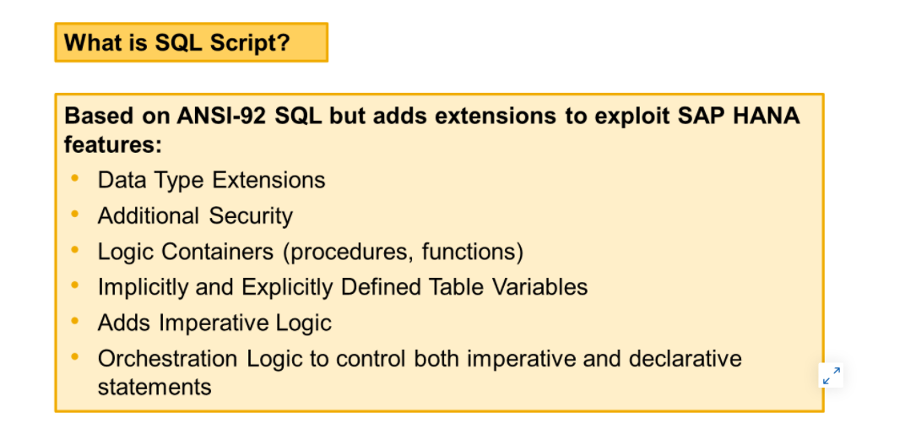
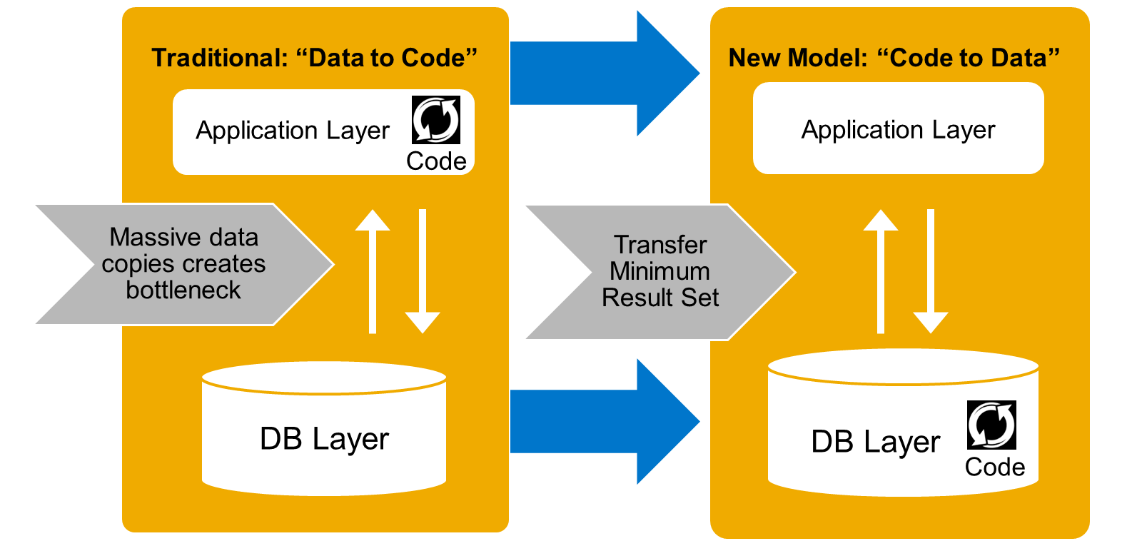
What is SQL Script?
SQL Script is a set of extensions added on top of standard SQL. It is used to exploit the specific features of SAP HANA.
By using these extensions, SQL Script allows much more pushdown of the data–intensive processing to the SAP HANA database, which otherwise would have to be done at the application level.
Applications benefit most from the potential of SAP HANA when they perform as many data-intensive computations in the database as possible. This avoids loading large amounts of data into an application server separate from SAP HANA, and leverages fast column operations, query optimization, and parallel execution.

Slide 5
Advantage of SQL Script
Compared to standard SQL, SQLScript provides the following advantages:
Using SQLScript, complex logic can be broken down into smaller chunks of code. This encourages a modular programming style which means better code reuse. Standard SQL only allows the definition of SQL views to structure complex queries, and SQL views have no parameters.
SQLScript supports local variables for intermediate results with implicitly-defined types. With standard SQL, it would be required to define globally visible views even for intermediate steps.
SQLScript has flow control logic such as if-then-else clauses that are not available in standard SQL.
Stored procedures can return multiple results, while a standard SQL query returns only one result set.
Pushing the processing to SAP HANA is beneficial because there are lots of opportunities for SAP HANA to optimize the execution with in–memory, parallel processing.
Standard SQL does not provide sufficient syntax to push many calculations to the database and as a result, the application layer has to take on this duty. This means huge amounts of data must be copied between the database server and the application server.

Slide 6
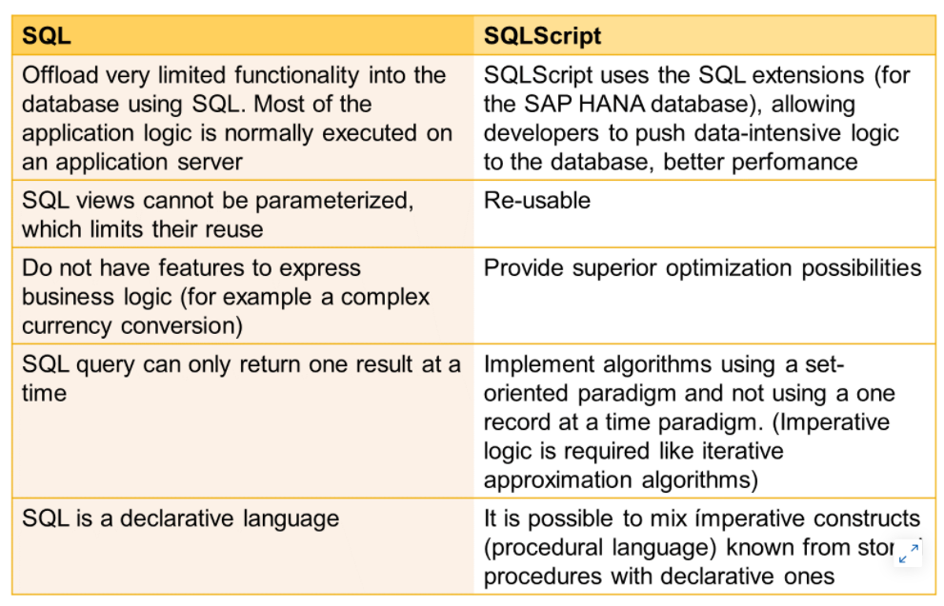
Standard SQL VS. SQLScript

Slide 7
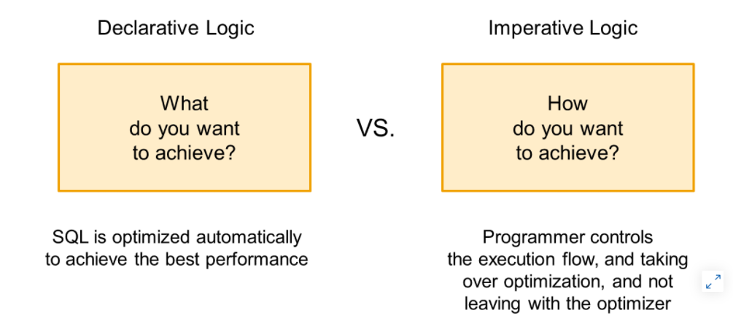
Types of SQL Script
SQL is a descriptive language that is sometimes called a declarative language.
Declarative logic allows the developer to declare the data selection via SELECT statements, as follows:
The developer defines the what.
The engine defines the how, and executes accordingly.
This enables massive parallelization.
Imperative logic allows the developer to control the flow of the logic within SQLScript using the following:
Scalar variable manipulation
DDL/DML logic
WHILE loops
Branching logic based on some conditions, for example IF/ELSE

Slide 8
Basic Rules of creating SQL Script
SQLScript is not case-sensitive like ABAP
Every SQL Script statement ends with semi-colon ;
When we create a variable and assign a value to it, we directly use variable name, but when we want to use the value of the variable we need to use the value of operator colon (:)
Declare x integer;
Declare y integer;
Declare z integer;
x = 10; z = :x + :y;
When we create a variable and do not assign value to it, a null will be assigned. And any operation will null will become null.
One of the best way to achieve code-to-data because the entire logic is processed inside the HANA system
In SQL script, everything evolves around SQL so even when we want to print a result on the screen we will use the SQL statement against a standard sap table called DUMMY;
In SQL script = is comparison operator and := is the assignment operator
When we open SQL Console, it always attaches to user’s local schema. Which means any runtime object created by console will go to user’s local schema (like local development in abap) - select current_schema from dummy
When we try to read data, we need to put schema name before table name in console
So we can also set the default schema using SET SCHEMA schema_name

Slide 9
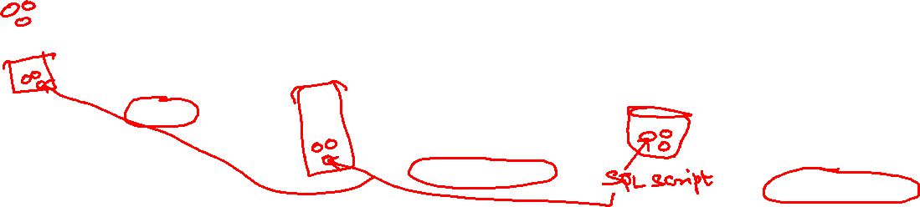
How to create SQL Script in HANA
Containers
Contain SQL Script Code
Functions (UDF)
Anonymous Block
Stored Procedures
Scalar
Table
Used for one time usage
Training, demo and testing
Do not store code
Complied every time we run
DO BEGIN
--Coda
END;
Code is compiled and stored in DB
Complete Reusability
Think about Function Modules in SAP ABAP
Can have IN, OUT, INOUT parameters
CREATE PROCEDURE procname(IN,OUT,..)
DEFAULT SCHEMA schemaname
READS SQL DATA
AS BEGIN
--Coda SQL Script
END;
User Defined Functions – UDF
Always have ONLY one RETURN parameter
Can have multiple Input parameters
Depending on return data, we will categorize
CREATE FUNCTION procname(....)
RETURNS datatype
DEFAULT SCHEMA schemaname
READS SQL DATA
AS BEGIN
--Coda SQL Script
END;

Slide 10
Data types in HANA
Data Types
Scalar Variables
Arrays
Tables
Used to store only one value
Used DECLARE statement
Char, Varchar, Nvarchar, String
DATE, TIMESTAMP
Integer, BIGINT, TINYINT, DECIMAL
CLOB, BLOB
Store multiple values of same data type
DECLARE arr_name datatype ARRAY;
Implicit
Explicit
1
Direct
Using Type
2
3

Slide 11



















We cannot return an array out of a container.

Slide 12
Create Anonymous Block
Anonymous block is an executable DML statement which can contain imperative or declarative statements.
All SQL Script statements supported in procedures are also supported in anonymous blocks. Compared to procedures, an anonymous block has no corresponding object created in the metadata catalog.
An anonymous block is defined and executed in a single step by using the following syntax:
DO [(<parameter_clause>)]
BEGIN [SEQUENTIAL EXECUTION]
<body>
END
<body> ::= !! supports the same feature set as procedure did
Hands-on: Anonymous blocks
Source code for SQL Script Basics

Slide 13
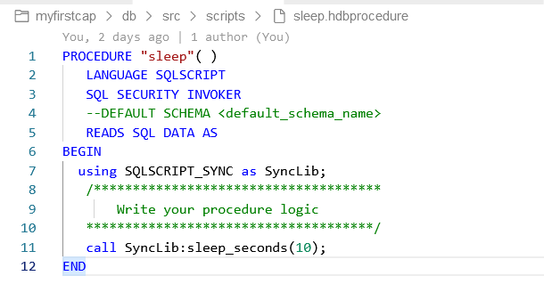
Hands-on: Create First Procedure
Create a simple SAP HANA Stored Procedure that calls the built-in SYNC library to put processing to sleep for 10 seconds.
Source code for Procedure basics

Slide 14
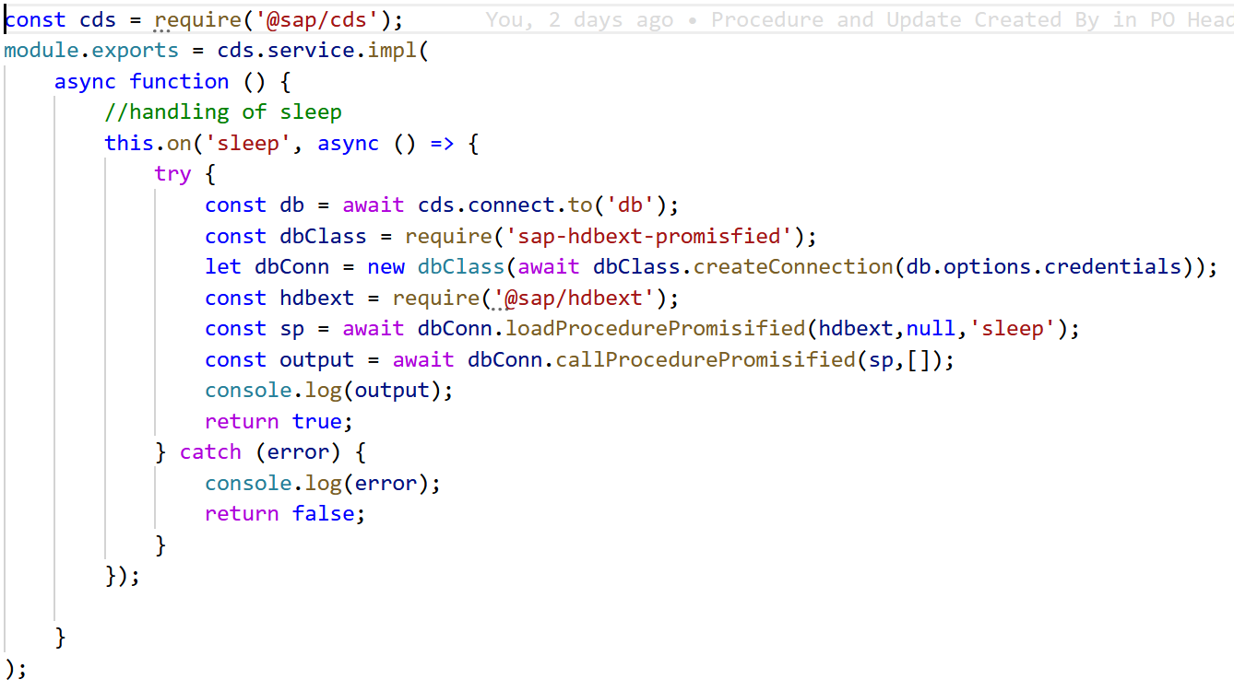
Hands-on: Expose Procedure as a Service
Now we want to add this Procedure to the CAP service as a function.
Source code for Consume procedure as a Service

Slide 15
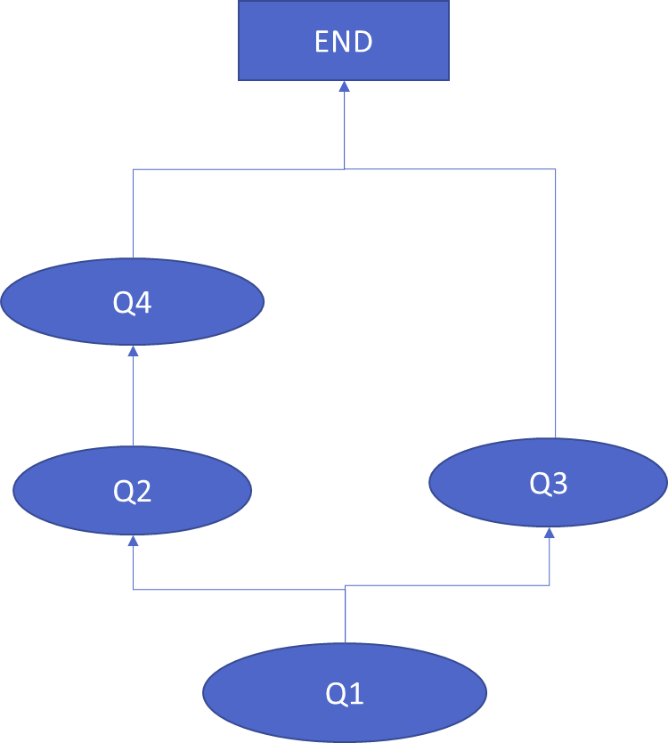
What is Data Flow Logic?
--Q1 (implicit table which gets created in HANA on fly)
Lt_prod = SELECT prod_id FROM products WHERE category = ‘Mice’;
--Q2
Lt_sales = SELECT customer, gross_amount FROM sls WHERE pid IN
( SELECT prod_id FROM :lt_prod );
--Q3
Lt_purchse = SELECT customer, gross_amount FROM purc WHERE pid IN
( SELECT prod_id FROM :lt_prod );
--Q4
Lt_total = SELECT customer, SUM(gross) FROM :lt_sales;
When HANA comes out of parallel mode
Whenever an DML/DDL statement is executed
Whenever an imperative logic is executed IF, LOOP
Whenever an explicit variable is created DECLARE
When a query result is not assigned to any implicit table
Rules
Split the code into multiple containers to keep each container work most time in parallel mode
Keep our imperative logic at end if possible

Slide 16
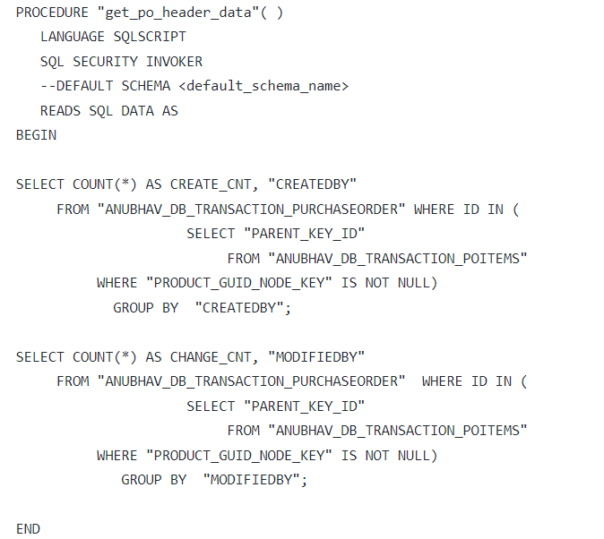
Create First procedure
A procedure is a reusable container which is compiled and stored inside HANA. They can be reused again and again by other procedures and services.
Simple Procedure to Read PO Data

Slide 17
More Exercise on Procedure
We can create procedure with IN, OUT and INOUT parameters to exchange data.
Parameterized Procedure
We can also retrieve the table data from procedure.
Table Data as Output from procedure

Slide 18
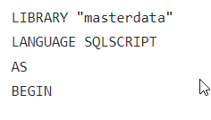
SQL Script Library
A SQL Script library is a collection of reusable procedure and functions, it is mainly used to group containers pertaining to particular area.
Example for SQL Script Library
Syntax and Steps
Create an hdblibrary artefact in SAP Business application studio
Define library using below syntax
Define functions/procedures in the library
Call library functions using libraryname:function_name

Slide 19
SQL Script UDF – User Defined Functions
Functions, or User Defined Functions (UDF), as they are more formally known, allow developers to capture a reusable block of SQLScript code that provides a result after working through some data processing logic. Often, functions allow input parameters to pass key information to the processing logic so that the function can be reused in different scenarios.
Functions are relevant to SAP HANA Cloud modeling because they offer a way to extend the standard capabilities provided with graphical calculation views to reach more complex data processing possibilities. Functions are written in SQLScript language using source files. After a successful deployment, a runtime object is generated from the source file. When executed, functions always run in the in-memory SAP HANA Cloud database, and so performance is optimized.
SAP HANA Cloud supports scalar and table functions. Table and scalar functions are created as source files in a project folder. The source file has the extension .hdbfunction The same extension is used for table and scalar functions.
Functions, both scalar and table, are always read-only. It is not possible to alter the database by using data definition statements such as create table, or data manipulation statements such as update.
Functions can call other functions which encourages a modular approach to ensure high reuse.
Example of SQL Script functions

Slide 20
Procedure v/s Functions
Procedures Functions
Can have multiple OUT parameters
We can have INOUT parameters
Called via call statement
Can be consumed in another procedure and function
Heavy weight
Functions always return ONE RETURN parameter
Do not support INOUT parameter
Always called using Queries
Can be consumed in another procedure and function
Light weight
There are 2 sub-types
SUM, MIN, COUNT, MAX..
Now since we are creating custom functions, we call them user defined functions - UDF
http://sap.optimieren.de/hana/hana/html/_gsql_functions.html

Slide 21
Debugging SQL Script code

Slide 22

End of Day 6

Slide 23

Questions

Slide 24

Anubhav Oberoy

Slide 25


We’re committed to empower you to be
Most Desirable Resource
through powerful training solutions.
We build the workforce of the future.
260+
Corporate Clients
30,000+
Learners Trained
26000+
Learners Placed
FREE WEBINARS
Sign up for free webinars with industry experts every fortnight!
Enroll Now!
Contact us today!
https://anubhavtrainings.com/

Slide 26




More from AnubhavTrainings.com

Slide 27
Title
Content

